Slide 1
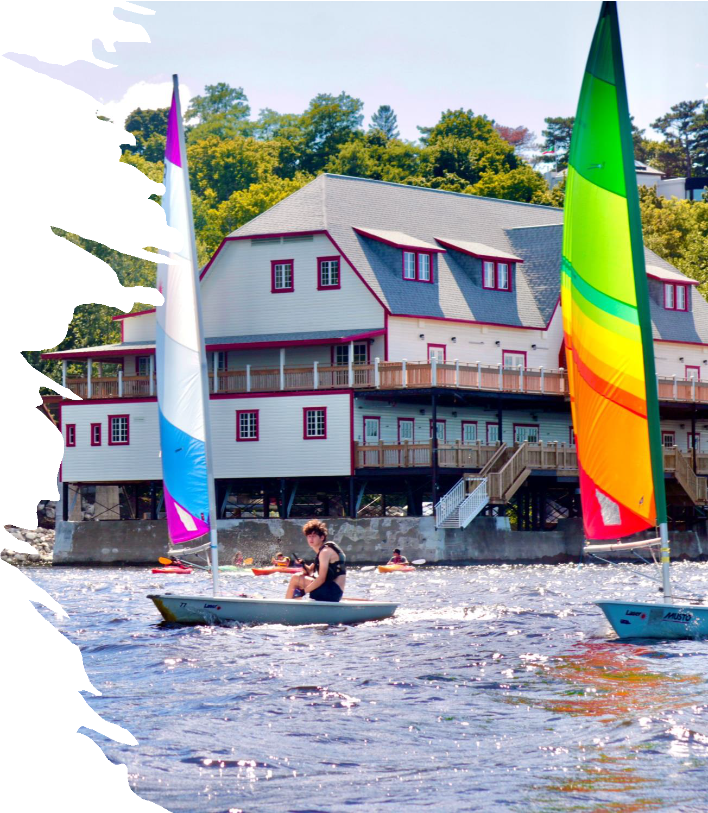
PARENTS’
HANDBOOK
ONEC Summer Camps

Slide 2
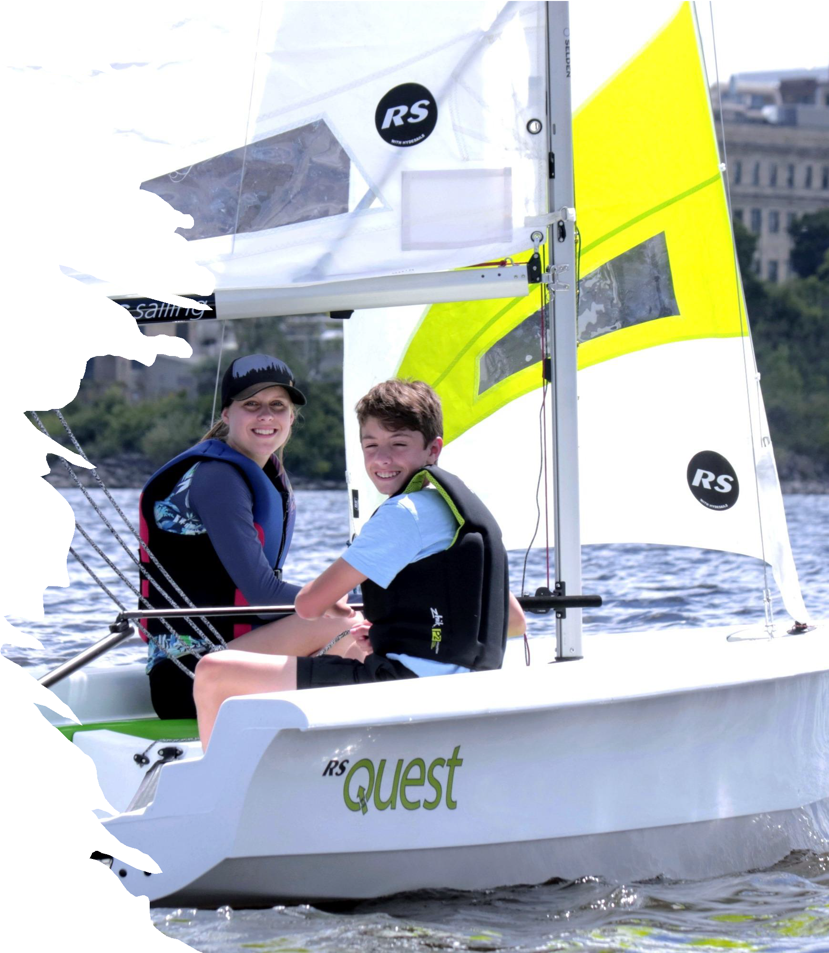
Summer Camps
The Ottawa New Edinburgh Club (ONEC) offers all you could possibly want from a summer camp. We have a team of dedicated, qualified and enthusiastic instructors, beautiful facilities, and a safe and friendly environment. We offer a wide variety of games, sports and activities all with a fun small-camp feel.

Slide 3
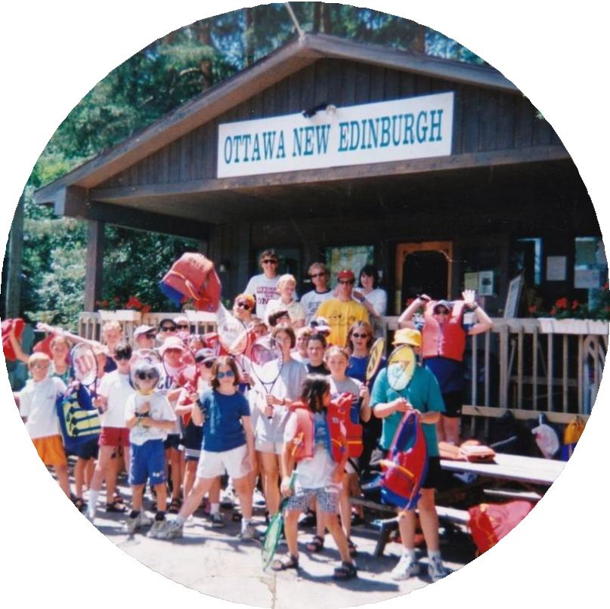
Facilities
ONEC’s central hub is the Sport & Camp Pavilion, which is located on Tennis Crescent Rd, south of the parkway—this is where all campers are dropped off and picked up at the start and end of the day.
Washrooms with showers are inside, along with a small canteen for lunchtime treats. Outside is a grassy yard with picnic tables.
Wrapping around the pavilion are the tennis courts, and across the road is the newly renovated, beautiful boathouse where sailing kayaking and rowing camps take place.

Slide 4
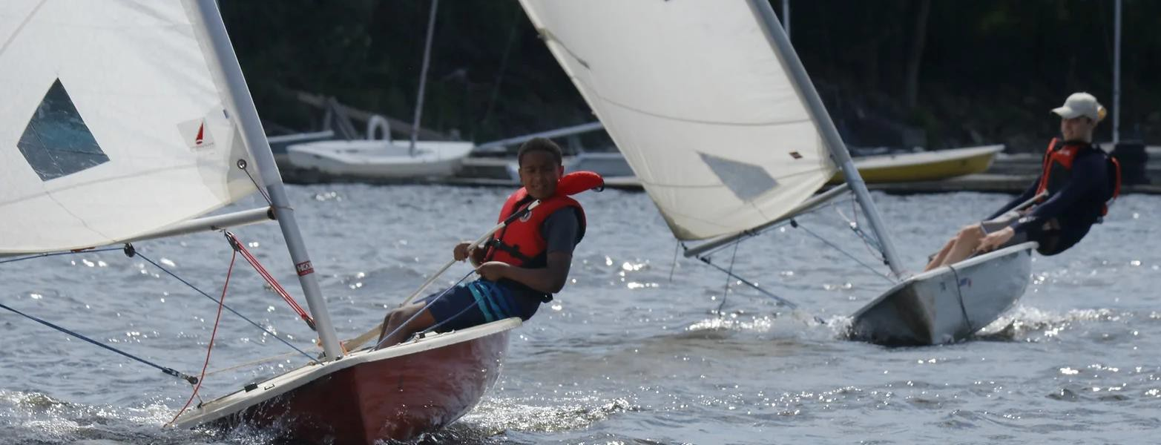
The Ottawa New Edinburgh Club’s sailing program exists to teach and promote water safety, the sport of sailing, and encourage skill development in a safe environment. The program emphasizes the enjoyment and lifetime benefits of active participation in sport.
Sailing

Slide 5
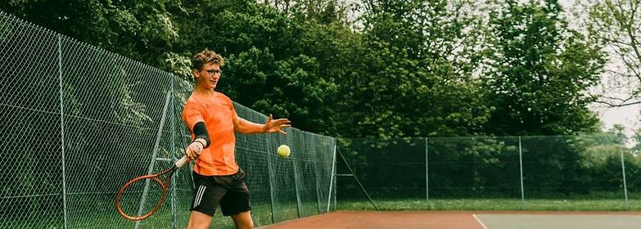
Our tennis program aims to provide your child with the basic fundamentals of tennis, to build his/her co-operation skills, court etiquette, self esteem and confidence—all the while creating an environment that fosters an appreciation and enjoyment of the game.
Tennis

Slide 6
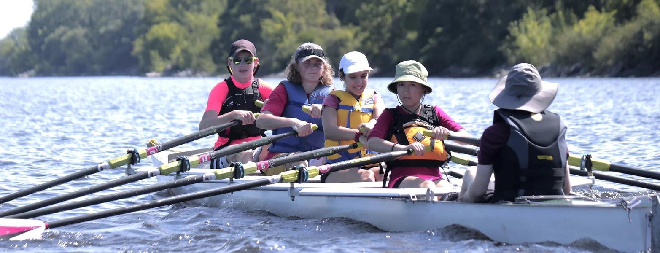
Our rowing program’s enrollment is kept small to give your child enough attention for them to truly hone their skills. It focuses on developing basic techniques so that campers can safely and confidently row in a variety of boats and conditions, and foster an enjoyment of the sport that will last a lifetime.
Rowing

Slide 7
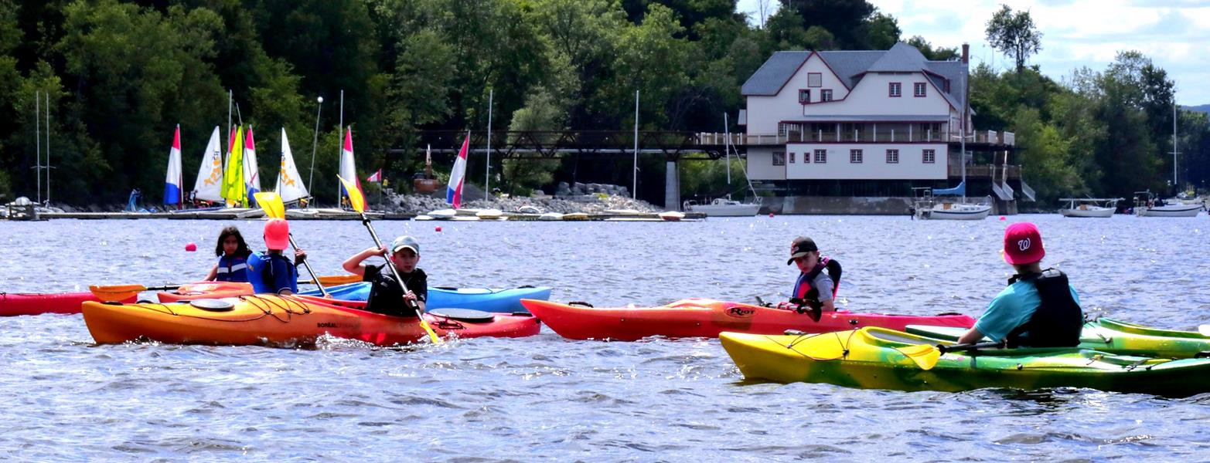
This summer get your child out on the water at an ONEC Kayaking and Stand-up Paddleboarding (SUP) Summer Day Camp! Kids will have fun developing paddling strokes and techniques (whether exploring a new sport or improving on skills leared last year), all while discovering the amazing Ottawa River, and making new friends! Day campers are taught by trained coaches.
Kayaking

Slide 8
Drop-Off and Pick-Up
Camp drop-off is between 8:30 am and 9 am at ONEC (504 Sir George Etienne Cartier Parkway) and pick-up is between 4 pm and 4:30 pm, at the follow locations:
Tennis: At the tent at the side of the tennis pavilion (far end of the parking lot)
Sailing / Rowing / Kayaking: At the tents in front of the tennis pavilion (far end of the parking lot)
Please make sure that your car is not blocking the road / parking lot as we have tennis members as well as other campers arriving at these times.
At drop-off on the first day, we will ask you to sign a Photo Release Waiver or, by declining, to let us know that you do not want photos of your child taken. (We try to take photos of the kids participating in the sports camps and share them with parents at the end of the week so that you can see what the kids have been learning at camp). We will also need you to sign a form if you wish your child to be able to sign themselves out of camp at the end of the day (e.g. local kids cycling home).

Slide 9
Daily Checklist
Before coming to camp make sure your child:
Has had a good night’s sleep and a good breakfast
Has a healthy, filling lunch packed. Proper nutrition is important!
Has a refillable water bottle
Wears sunscreen, hat, and sunglasses
Has running shoes and comfortable clothes
Tennis Racket (for tennis), Lifejacket or PFD (for watersports)
Arrives on time

Slide 10
Waterfront Checklist
For Sailors, Rowers and Kayakers
Bring a change of clothes, as you could get wet any day!
Appropriate gear for the weather, as we sail/ paddle rain or shine
It’s often much colder on the water than on shore.
For sailing: Strap-on shoes; nothing that can fall off or float
Old gym sneakers, water socks and strap-on sandals are great.
Flip-flops are a no-go.
For rowing & kayaking: water shoes or old gym shoes are needed.

Slide 11
Friday BBQ
No need to pack a lunch for Friday – as a BBQ lunch is provided. Vegetarian options are available.

Slide 12
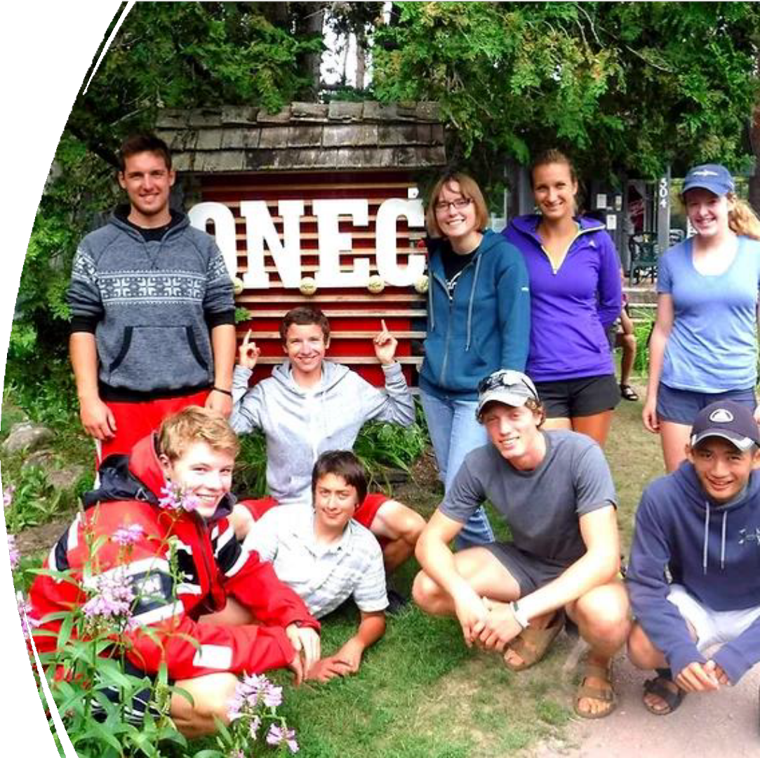
Camp Counsellors
Our Camp Counselors are often ONEC camp graduates and are very familiar with the Ottawa River and its safety requirements. They are also highly trained in their individual sports, ensuring we are providing high quality sports training in a friendly, accepting atmosphere.

Slide 13
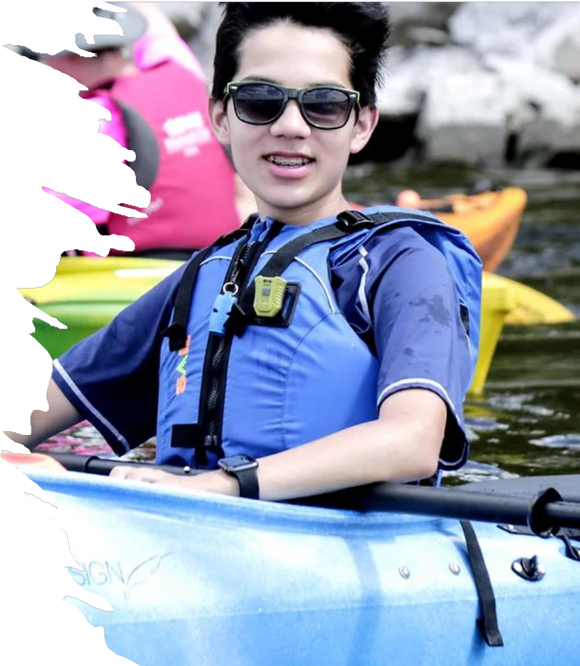
FAQ
Q I have a concern or issue. Who should I talk to?
A The instructor can usually be your first stop for resolving most issues. The best time to talk to the instructor is before or after class. If this is not convenient, please call and leave a message at the club office with the manager.
Q My child is going to be late, what should I do?
A Please phone the pavilion, and leave a message with the staff (613-746-8540). Same thing applies to days when your child will be absent.
Q My child is reluctant to come to class.
A Unwillingness to come to camp can be caused by any number of things: fear, an incident with fellow campers, or simply being tired. Regardless, if your child isn’t comfortable, we want to know about it! ONEC instructors are well versed in the art of coaxing and motivating reluctant students.
Please contact your child’s instructor if he/she has any
concerns.

Slide 14
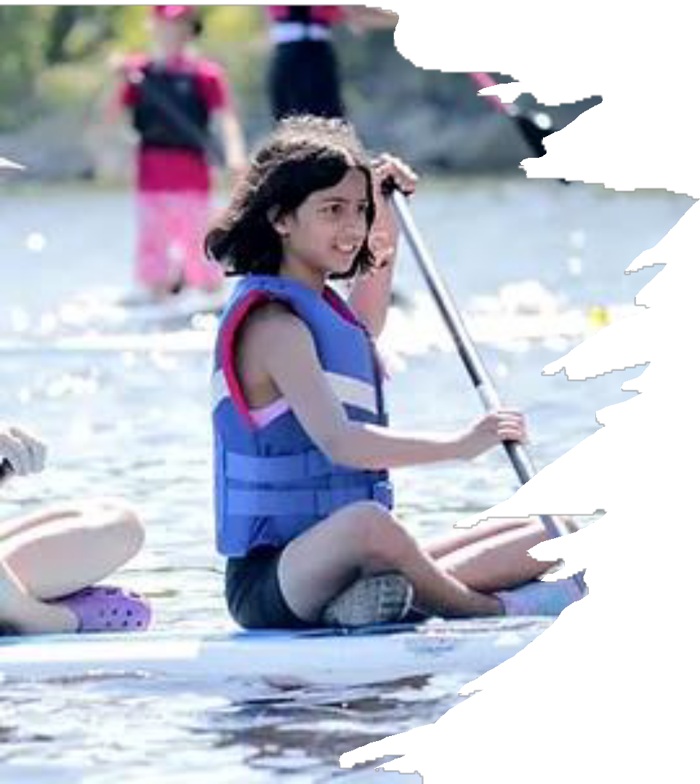
FAQ
Q What happens if my child is injured at camp?
A Any time an instructor is required to administer first aid for a cut, bruise or a banged head, they will complete an injury report. We will do our best to contact you to advise you of the injury and the treatment. All of our instructors are certified in standard first aid.
Q What happens when it rains?
A Tennis courts can’t be used when wet, so campers will go to the camp tents to play games. A little rain doesn’t stop sailors kayakers or rowers though, so make sure your child comes dressed appropriately for the weather, with lots of layers and a change of clothes. If there is any sign of a thunderstorm, boaters will stay inside too.

Slide 15
Camp Behaviour
ONEC has developed the following behavioural rules and guidelines to help ensure a safe, rewarding, and fun learning environment. It is important that both you and your child review these rules and guidelines. Appropriate behaviour is expected at all times.
No violent or abusive behaviour.
All students are expected to show up ready to learn.
Students must follow instructions from the instructors and staff.
Life jackets must be worn at all times on the water and docks.
Consequences for failure to observe the above rules and guidelines vary according to the nature of the infraction, but can include loss of privileges, and ‘time out’. Any verbal or physical abuse (or if your child’s behaviour jeopardizes his/her own safety or the safety or enjoyment of another camper) will result in early dismissal from class with a warning to both the parent and the student. A second incident will result in the student’s dismissal from the remainder of the session. There will be no refund of fees.

Slide 16
Camp Safety
We take safety seriously. Please go over the following rules with your child prior to their participation in ONEC day camps.
Life jackets must be worn at all times on the stairs, docks and
water.
Wear secured shoes while on the stairs, dock and water.
Wear an appropriate amount of clothing.
No smoking, alcohol or drugs.
Don’t leave the docks unless the instructor says so.
Swimming is only allowed while an instructor is supervising.
If you hear lots of whistles (and a red flag), head in immediately.
Stay away from Out of Bounds areas.
Workshop, hoists, rocks, rowing scullery, construction work areas, etc.
Don’t leave your group without permission from your instructors.
Use the buddy system. No day camp participants should be
alone.
Only cross the road with a coach or coach-in-training.
Respect all boating equipment and do not let equipment drag on the ground.
Respect instructors and listen attentively when they are talking
Respect each other (no fighting, name calling or bullying at any time).
Use recyclable or reusable plastic bottles for drinking water (no
glass).
Help keep the sailing school tidy and don’t litter (clean up at the
end of day).
Obey capacity limits on all boats.
Don’t climb or jump out of boats while they’re in motion.
Keep fingers away from being in between the boats and dock
while at dock.
Make sure everything is properly put away at the end of each day.
And the most important of all: Have fun!

Slide 17
A Note on Concussions
Concussions are a health issue that have been in the news the past few years. While rowing and tennis participants have a minimal risk of getting a concussion, the risk is higher for participants in sailing.
In accordance with ONEC procedures, you will be advised if your child sustains a direct or indirect force to the head. We strongly recommend that you familiarize yourself with the following:
Ontario Sailing Concussion Policy
Row Ontario Concussion Policy
Parachute Concussion Information and Resources
Please note that although helmets are not required to be worn at sailing camp, some sailors have started to wear them while practicing the sport in order to reduce the risk and impact of concussions. There will be a zero-tolerance policy for anyone making fun of another camper for wearing a helmet.

Slide 18
Questions?
Contact us at summercamp@onec.ca Call us at 613-746-8540
Learn more at: onec.ca/camps

